Slide 1

NODE JS
Aruna S
Department of
Computer Science and Engineering

Slide 2

NODE JS
File System Module
S. Aruna
Department of Computer Science and Engineering

Slide 3

NODE JS
File System Module
Node implements File I/O using simple wrappers around standard POSIX functions.
The Node File System (fs) module can be imported using the following syntax −
Synchronous vs Asynchronous
Every method in the fs module has synchronous as well as asynchronous forms.
Asynchronous methods take the last parameter as the completion function callback and the first parameter of the callback function as error.
It is better to use an asynchronous method instead of a synchronous method, as the former never blocks a program during its execution, whereas the second one does.

Slide 4
NODE JS
Fs module operations
Common use for the File System module:
Read files
Create files
Update files
Delete files
Rename files

Slide 5
NODE JS
Fs File Open
Syntax
Following is the syntax of the method to open a file in asynchronous mode −
fs.open(path, flags[, mode], callback)
Parameters
Here is the description of the parameters used −
path − This is the string having file name including path.
flags − Flags indicate the behavior of the file to be opened. All possible values have been mentioned below.
mode − It sets the file mode (permission and sticky bits), but only if the file was created. It defaults to 0666, readable and writeable.
callback − This is the callback function which gets two arguments (err, fd).
Flags for read/write operations are − r,r+,rs,rs+,w,wx,w+,wx+,a,ax,a+,ax+

Slide 6
NODE JS
Fs File Write
Syntax
fs.writeFile(filename, data[, options], callback)
This method will over-write the file if the file already exists. If you want to write into an existing file then you should use another method available.
Parameters
path − This is the string having the file name including path.
data − This is the String or Buffer to be written into the file.
options − The third parameter is an object which will hold {encoding, mode, flag}. By default. encoding is utf8, mode is octal value 0666. and flag is 'w'
callback − This is the callback function which gets a single parameter err that returns an error in case of any writing error.

Slide 7
NODE JS
Fs File Read
Syntax
fs.read(fd, buffer, offset, length, position, callback) This method will use file descriptor to read the file. If you want to read the file directly using the file name, then you should use another method available.
Parameters
fd − This is the file descriptor returned by fs.open().
buffer − This is the buffer that the data will be written to.
offset − This is the offset in the buffer to start writing at.
length − This is an integer specifying the number of bytes to read.
position − This is an integer specifying where to begin reading from in the file. If position is null, data will be read from the current file position.
callback − This is the callback function which gets the three arguments, (err, bytesRead, buffer).

Slide 8
NODE JS
Fs File Close,Delete,Truncate
Unlinking a File
Use fs.unlink() method to delete an existing file.
fs.unlink(path, callback);
Closing a File
fs.close(fd, callback)
fd − This is the file descriptor returned by file fs.open() method.
callback − This is the callback function No arguments other than a possible exception are given to the completion callback.
Truncate a File
fs.truncate(fd, len, callback)
fd − This is the file descriptor returned by fs.open().
len − This is the length of the file after which the file will be truncated.
callback − This is the callback function No arguments other than a possible exception are given to the completion callback.

Slide 9
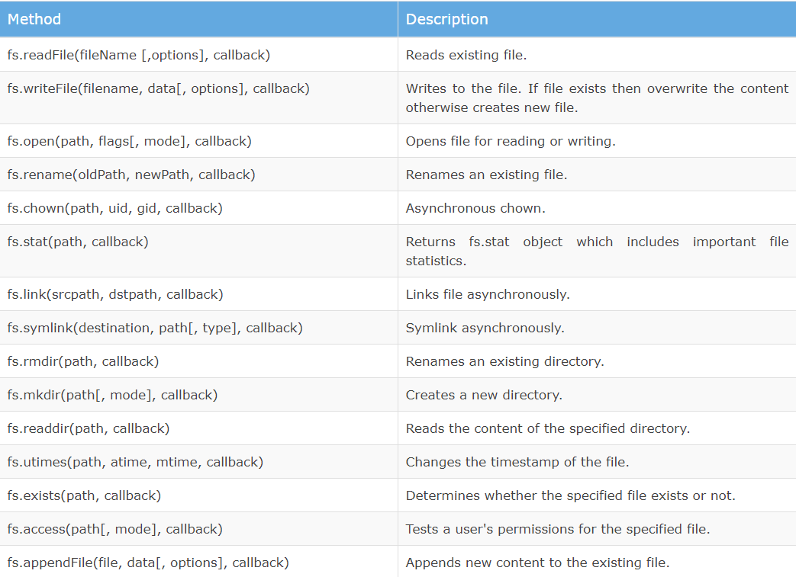
NODE JS
Fs Module – Other Important Methods

Slide 10
THANK YOU
Aruna S
Department of
Computer Science and Engineering
arunas@pes.edu

